Slide 1
What is a Tympanometer
A handheld tympanometer is a medical device designed to evaluate the condition and mobility of the middle ear by measuring how the eardrum responds to changes in air pressure in the ear canal. This test, called tympanometry, helps clinicians determine whether hearing loss is due to middle ear problems (conductive) or inner ear/auditory nerve issues. Handheld models are particularly valued for their portability, ease of use, and suitability for diverse environments - making them essential tools for audiologists, ENT specialists, and hearing care professionals.
Handheld tympanometers are portable devices used to assess middle ear function and eardrum mobility, offering quick, accurate measurements in various clinical settings.

Slide 2
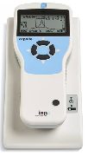
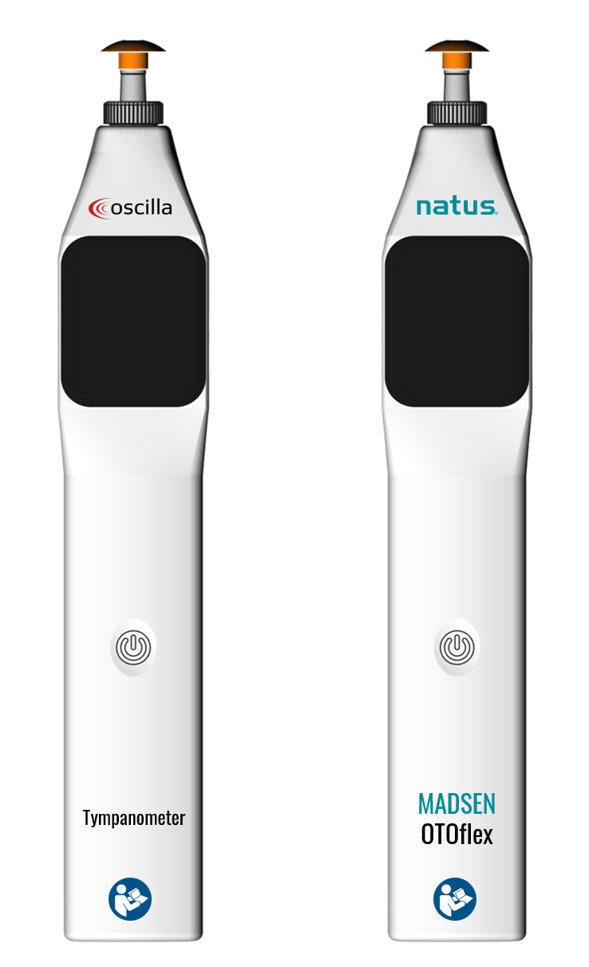
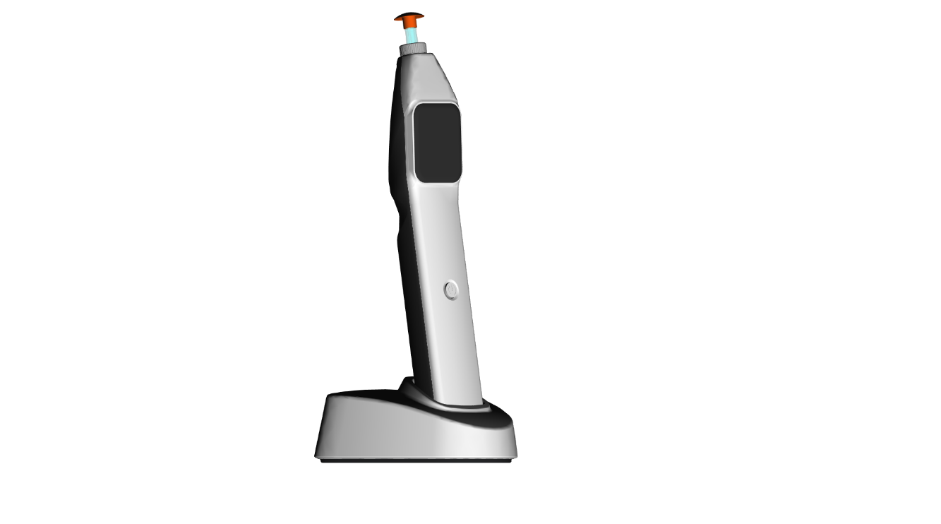

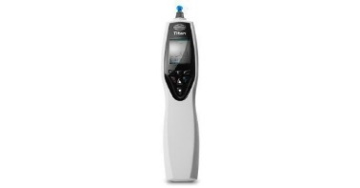

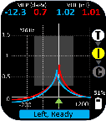


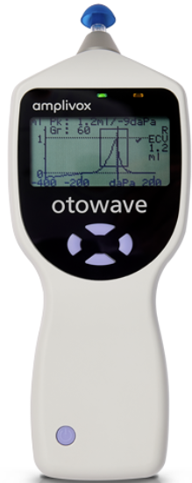

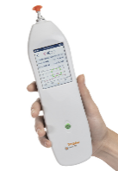

Hand-held Tympanometer
Key Competitors*
  GSI Alegro
  Interacoustics Titan
  MAICO EasyTymp
  Amplivox Otowave
  Inventis Timpani
Aeris
Key selling points
Most Compact (Dimensions)
Lowest weight hand-held in the market (160g)
Best-in-Class or = to BiC
Ergonomic shape (HandHeld Pencil hold)
HR Smart screen (Digital face)
Competitive pricing
* All of the above competitors are part of the Demant Group

Slide 3
Product Introduction
Proposed product name: Aeris
Value proposition:
  Aeris redefines tympanometry through the perfect balance of lightness, and speed. As the smallest and lightest device in its class, it enables effortless, rapid screening wherever care is needed. Powered by a patented tympanometry process and the fastest sweep available, Aeris delivers accurate results in seconds—bringing clarity and confidence to every assessment.
Smallest device (21x3,5x3,2cm)
Lightest device (160 g)
Patented technology (pump + tymp engine)
Fastest sweep available (600 daPa/sec)
Small size supports portability, storage, ergonomics and one-handed operation for easier stabilization in patient’s ear + achieving probe seal required in busy clinical settings and when chasing children
Low weight supports portability - especially in high-volume screening such as high turnover clinics and Paediatric Audiology sectors
Patented pump and tymp engine enables device size + provides customers the convenience of quick screening
Fast sweep speeds up exam + helps maintain seal integrity during exam for fewer re-tests – both support higher patient throughput

Slide 4

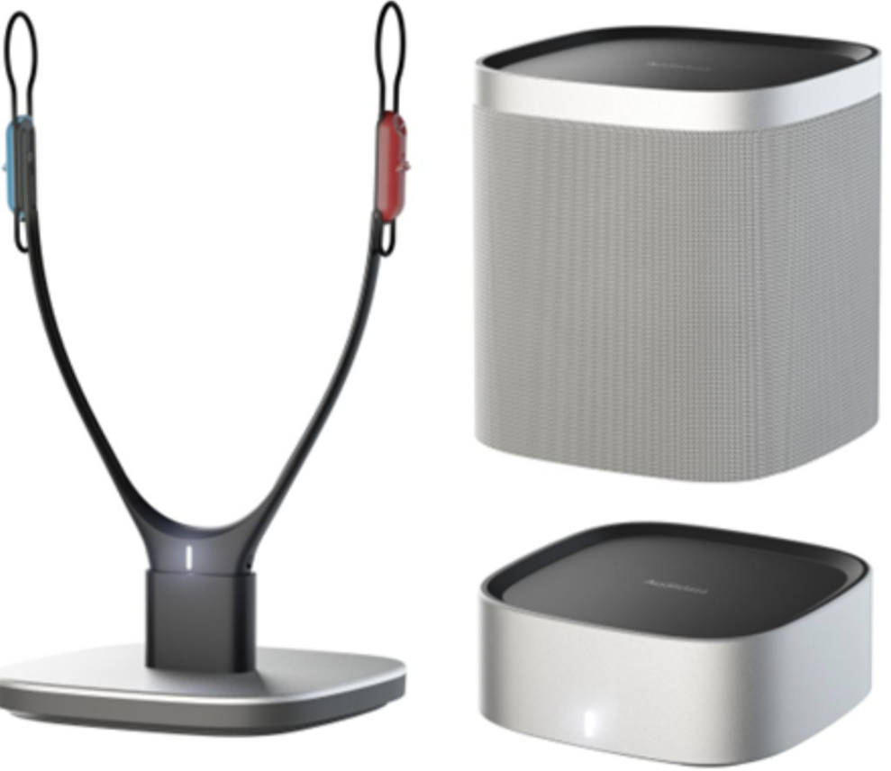
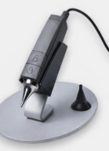
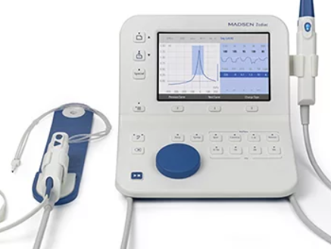
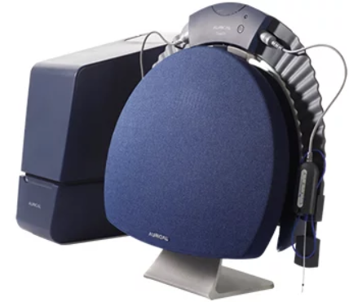
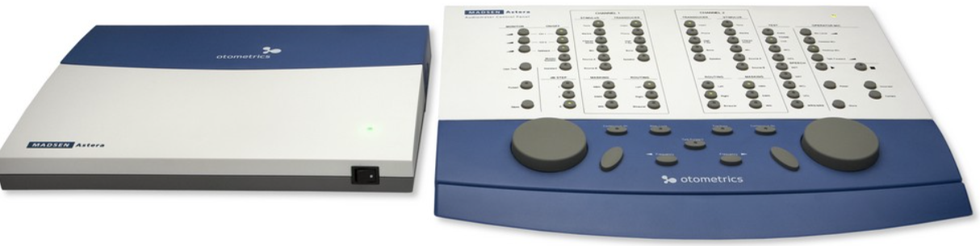
New Hand-held Tympanometer
Device and Capability | Customer Segmentation | Price/value positioning | Feature Set | Adjacency Products
Aeris | Hearing Dispensing retail chains Mom and Pop Shops ENT departments | Low-Mid | Compact with low foot-print light and portable ease of use with non-compliant patients quick-usage affordable | Otocam Measure Aud Measure Fitting Consumables Service
Zodiac | Audiologist Hospital based departments- VA/ NHS Specialised clinics | Mid-High | Dedicated test space User configurable full clinical feature set Printer option integrated solution ergonomic Reliable. | Otocam Aurical/ Astera Freefit HIT Consumables Service

Slide 5


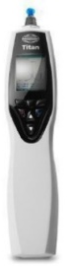
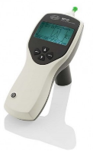
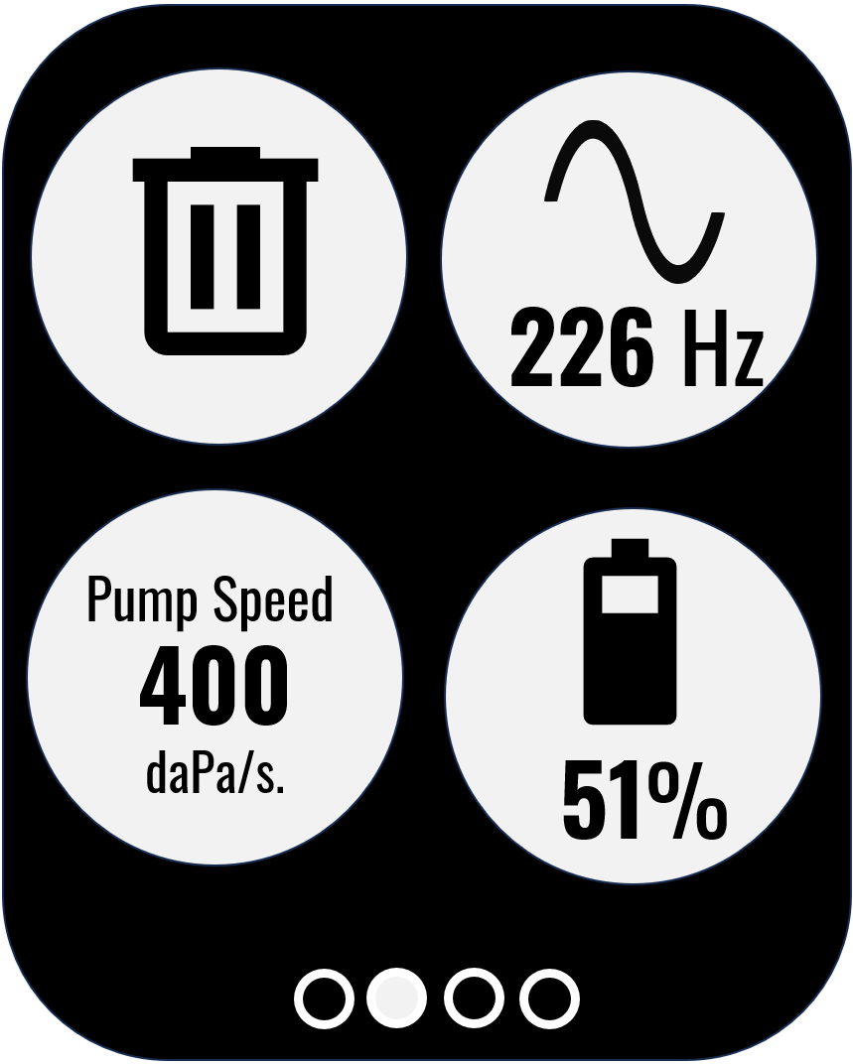
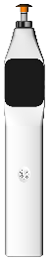
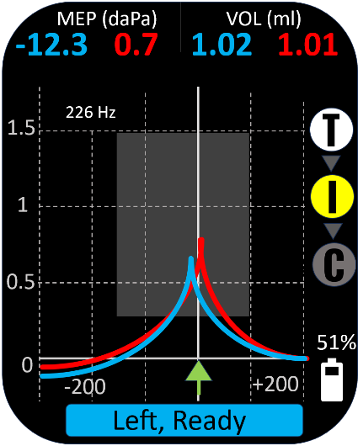
Product: | Inventis Picolo | IA Titan Maico easyTymp | IA MT10, Amplivox Otowave GSI Allegro | Oscilla T20 Natus Madsen Otoflex
Probe Frequencies: | 226 Hz | 226 Hz | 226 Hz | 226 Hz
HF Probe Frequencies: | 1000Hz (Optional) | 678, 800 and 1000Hz (Optional) | No | 678, 800 and 1000Hz (Optional)
ipsilateral reflex | 0.5, 1, 2 and 4 kHz (Optional) | 0.5, 1, 2 and 4 kHz (Optional) | 0.5, 1, 2 and 4 kHz (Optional) | 0.5, 1, 2 and 4 kHz (Optional)
Contralateral reflex | No | Optional | No | Optional
Reflex levels | Min: 70 dB HL Max: 100 dB HL | Min: 70 dB HL Max: 105 dB HL | Min: 70 dB HL Max: 100 dB HL | Min: 70 dB HL Max: 105 dB HL
Max. Pump Speed | 400 daPa/sec | 600 daPa/sec | 300 daPa/sec | 600 daPa/sec
Wideband Tympanometry | No | (Optional) | No | No
High resolution colour display | Yes, High Resolution | Yes, Low resolution | No, Monochrome | Yes, High Resolution
Capacitive touch | Yes | No | No | Yes
Docking station | (Optional) | (Optional) | (Optional) | Yes
Clinical Probe | No | (Optional) | No | No
Lithium battery | Yes | Yes | No, Alkaline | Yes
Carrying case | Yes | (Optional) | No | Yes
Weight | 340 g | 360 g | 380g | 160 g
Dimensions (mm) | 240 x 65 x 44 | 280 x 60 x 60 | 190 x 80 x 40 | 210 x 35 x 32
Medical device CE Class | IIa | IIa | IIa | IIa
Released under EU 2017/745(MDR) | No, MDD | No, MDD | No, MDD | Yes
Notes:
226Hz standard probe frequency for adults
For infant’s higher test frequencies are needed as the middle ear and ear canal are still very compliant
Acoustic reflex
Ipsilateral reflex (same ear)
Contralateral reflex (opposite ear)
Reflex levels:
Reflex varies from person to person – some show a reflex at lower levels than others (70-100 dB adjustability)
Audiologists look for lowest intensity at which reliable reflex can be measured
Reflex tones can be tested with tones 0,5; 1; 2 and 4 kHz – or broadband noise (Interacoustics)
Different dB levels are needed as reflex thresholds vary by stimulus type and frequency
Pathology – some pathology can raise or eliminate the reflex (middle ear dysfunction, retrocochlear lesions, sensorineural hearing loss)

